Slide 1
LG Boosting algoritham
Slides

Slide 2
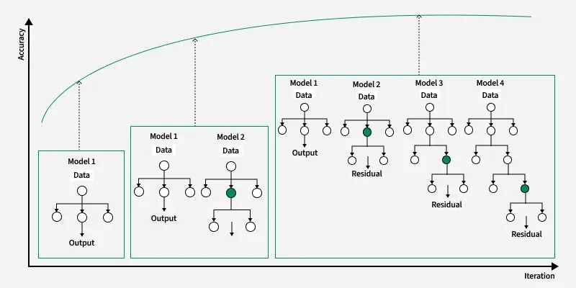
LG Boosting working Diagram

Slide 3
LGMBoost logic
Uses Leaf-wise tree growth (grows the specific leaf that reduces loss the most) instead of Level-wise (grows all leaves at the same level, like XGBoost)All model average consider as prediction
Also uses Histogram-based binning—instead of sorting floating-point values, it bins them into discrete integers (e.g., 0–255) to speed up training dramatically.
Grows leaf-wise (fastest, but deeper trees) vs XGBoost level-wise (slower, but balanced). LightGBM is faster on huge datasets (>100k rows).

